Slide 1


TSA: Forecasting of Store Sales
Presented By: Selva Rama Bala Subramanian S
Mentors:
Ms. Komilla Bhatia
Ms. Nisha Jenipher

Slide 2
Agenda
Introduction
Business Scenario
Algorithms
Forecast of Sales
Summary
Presentation Title

Slide 3

Introduction:
Time series analysis is a specific way of analyzing a sequence of data points collected over an interval of time. In time series analysis, analysts record data points at consistent intervals over a set period of time rather than just recording the data points intermittently or randomly.

Slide 4


Business Objective
FORECAST the sales of a store

Slide 5





Model selection and Evaluation:
Choose the model
Ljung Box Test
Forecast the model
Find the accuracy of the model
Best Model
ARMA
ARMA with Exponential Smoothing
ARIMA
SARIMA
Prove whether the model is good or bad using Ljung Box Test.
Forecast the model and Plot the actual and forecasted values.
Calculate the MSE and RMSE Score of the each model for the comparison.
Choose the best model with least RMSE Score.

Slide 6
FORECAST OF OFFICE SUPPLIES:
Stationarity Check
p-value > 0.05, It is not Stationary data
ARIMA and SARIMA Models
Hyper Parameters Tuning of Models
For ARIMA best model is p = 1, d = 1, q = 1
For SARIMA best model is P = 2, D = 1, Q = 2, m = 12
Forecast
Best Model is SARIMA, plotted actual and forecasted sales
There is increasing of sales in upcoming years for office supplies

Slide 7
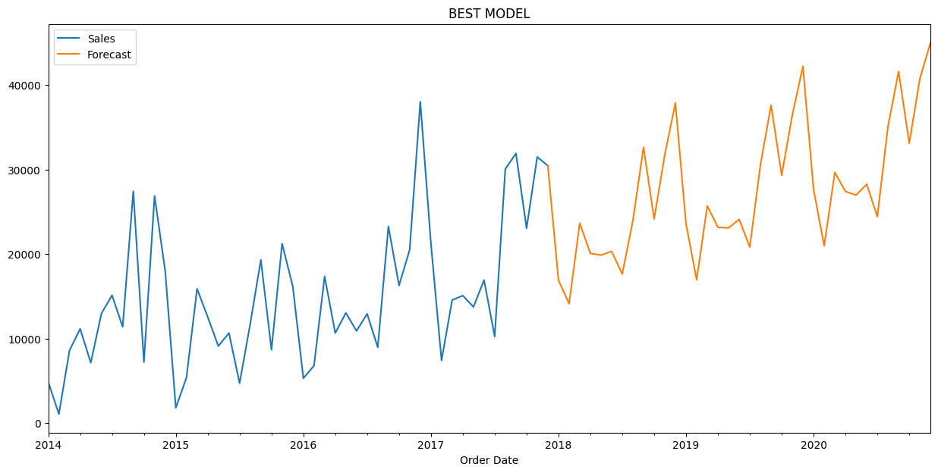

Forecast of Office supplies Sales:

Slide 8
FORECAST OF FURNITURES:
Stationarity Check
p-value < 0.05, It is a Stationary data
ARMA and ARMA with Exponential Smoothing Models
Hyper Parameters Tuning of Models
For ARMA best model is p = 9, d = 0, q = 2
For ARMA with Exponential Smoothing best model is p = 2, d = 0, q = 1
Best Model is ARMA, plotted actual and forecasted sales
There is decreasing of sales in upcoming years for furniture category
Forecast

Slide 9
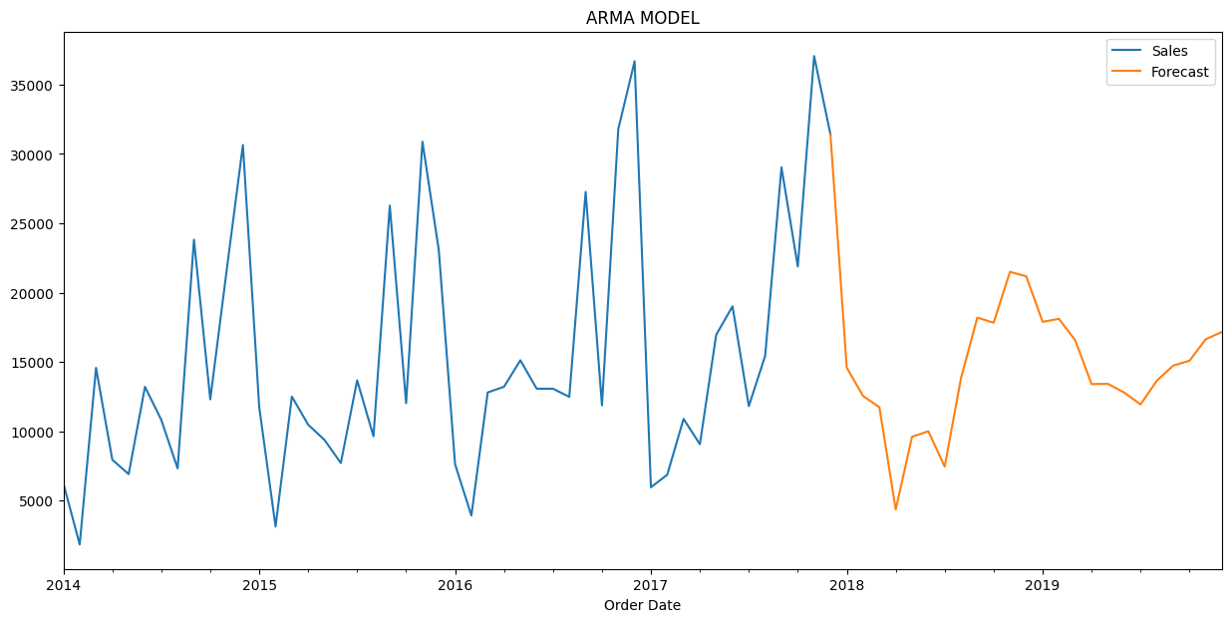
Forecast of Furniture Category

Slide 10
FORECAST OF TECHNOLOGY:
Stationarity Check
p-value < 0.05, It is a Stationary data
ARMA and ARMA with Exponential Smoothing Models
Hyper Parameters Tuning of Models
For ARMA best model is p = 1, d = 0, q = 1
For ARMA with Exponential Smoothing best model is p = 5, d = 0, q = 2
Best Model is ARMA, plotted actual and forecasted sales
There is decreasing of sales in upcoming years for technology category
Forecast

Slide 11
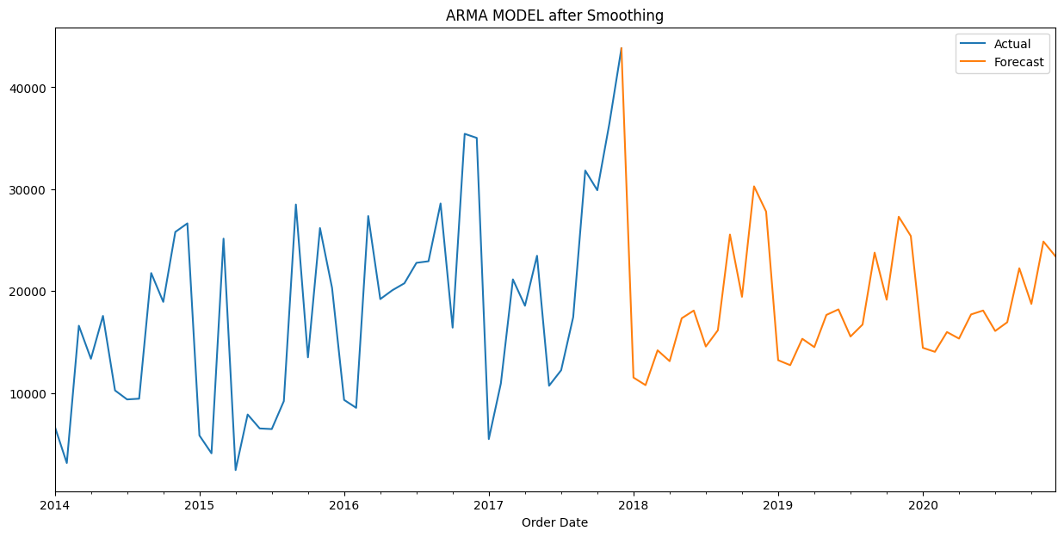
Forecast of Furniture Category

Slide 12
Business Summary:
Several Steps to increase the Sales of a Store:
1) By Implementing Loyalty for Customers:
Loyalty program is the best way to reward customers for their patronage and retain that loyalty. This is a powerful way to get more customers to return. E.g.: For every purchase customer will gain some points and When a points reaches to certain levels, that particular customer will get special gifts based on their loyalty points.
2) Item Visibility of High-selling Products:
Making shopping an easy experience is another way to increase your retail store sales. Manage your product shelves in ways that make the products easily visible and available to the consumers.

Slide 13

Thank you

